Slide 1

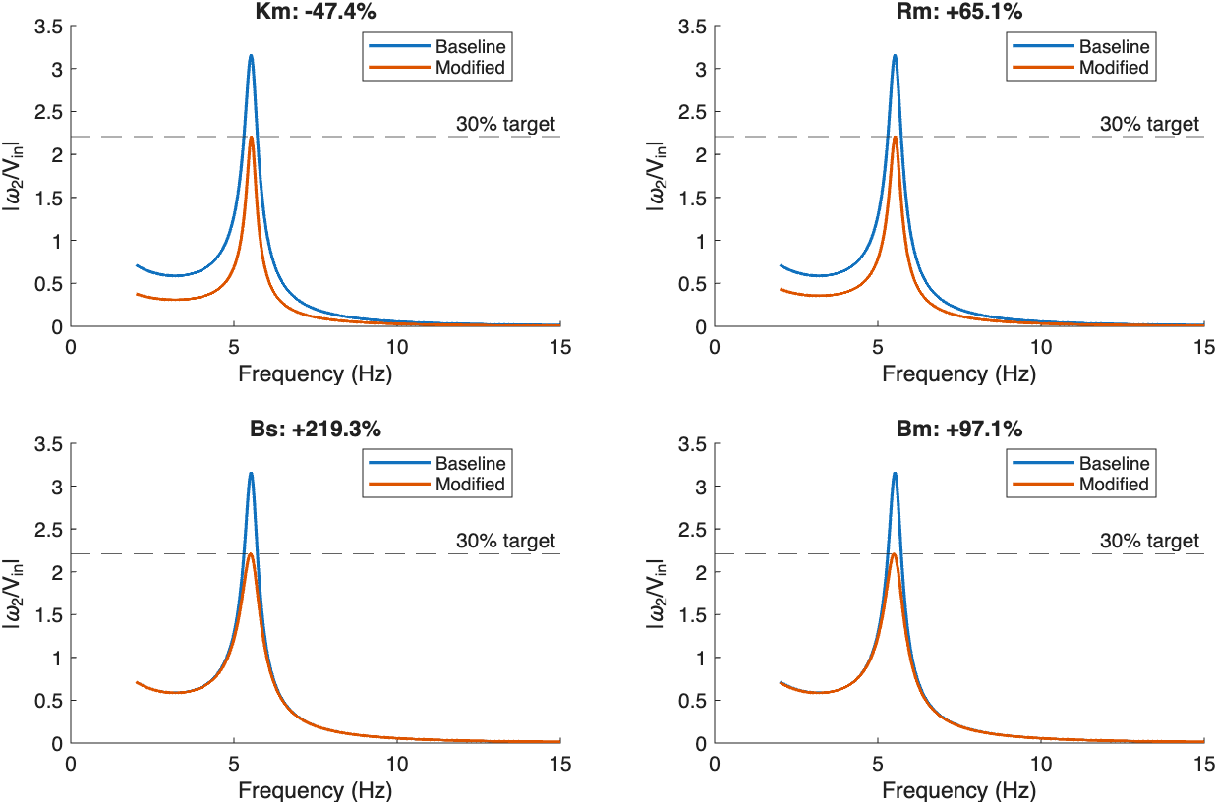
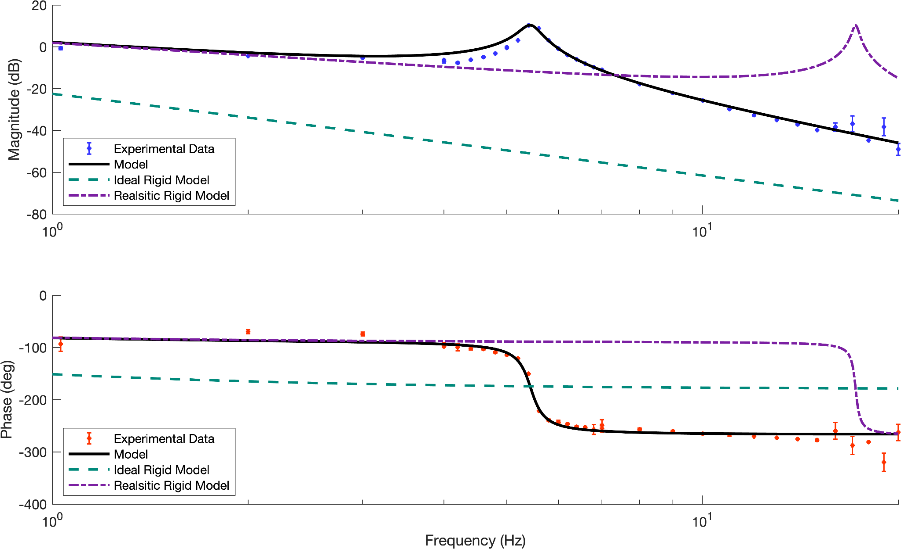
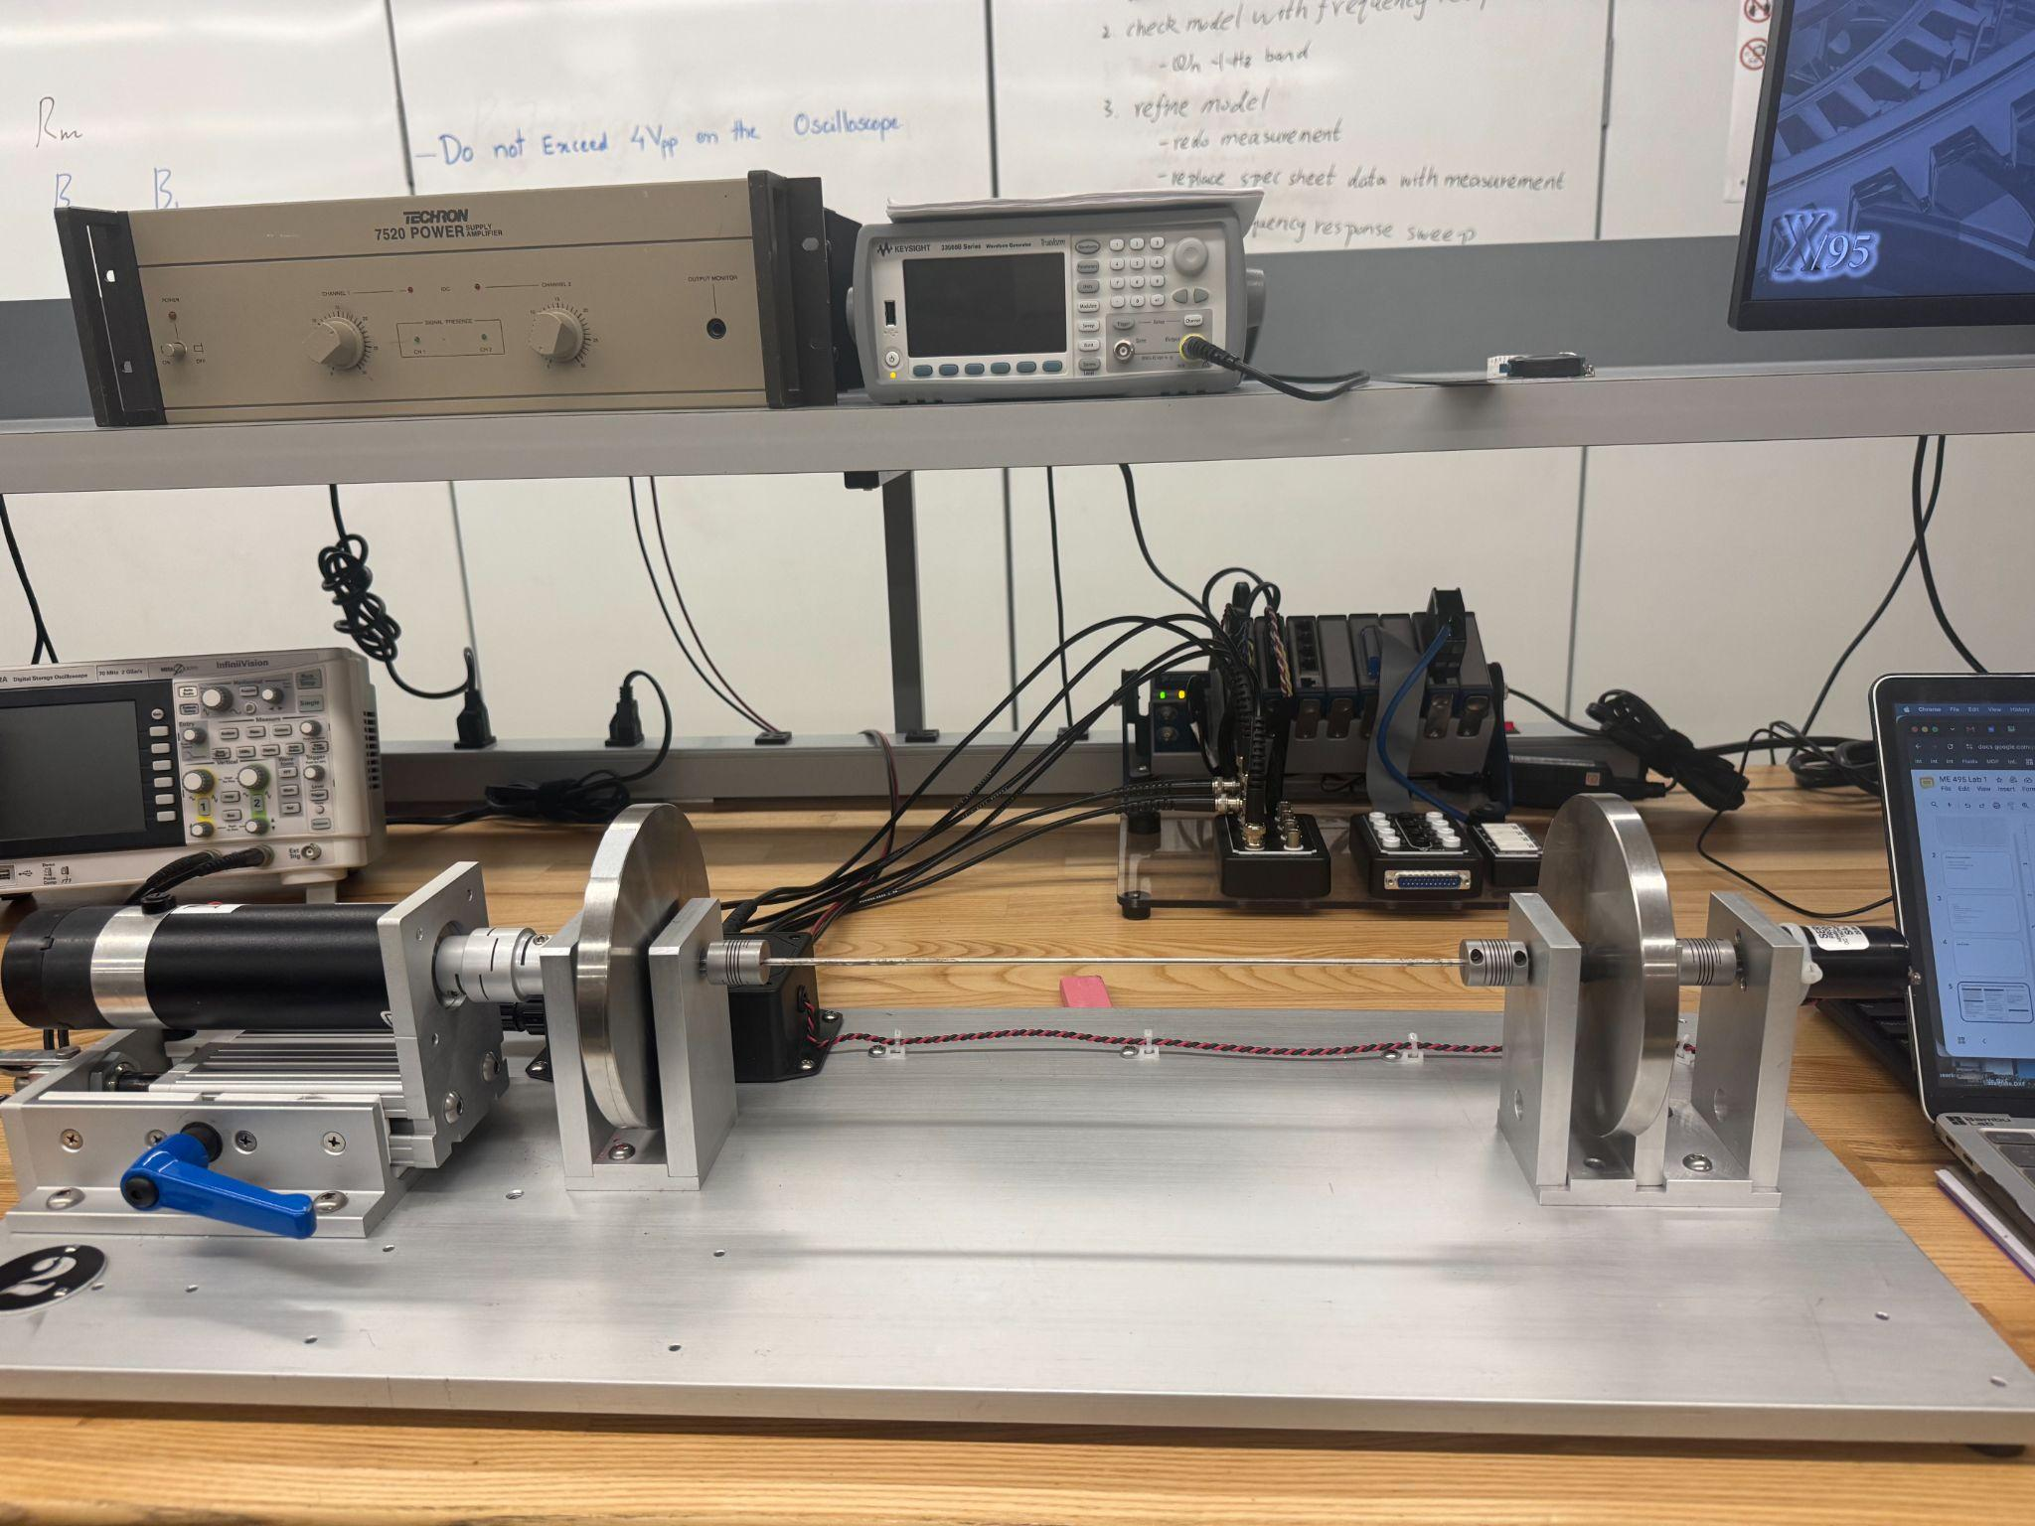
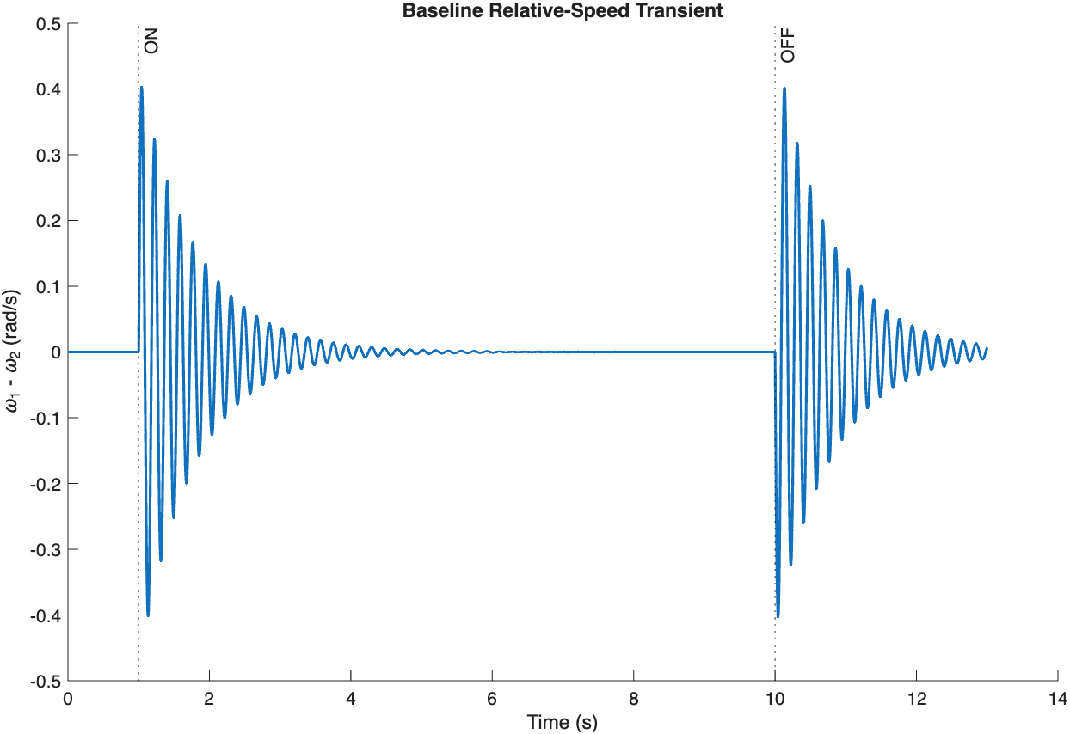
Reducing Drive Shaft Vibrations in Gulo 3000 Prototype Hybrid Electric Model
Evers Baskey, Sophia Dragich, Evan Link, Vrinda Thakur
Background
Model Validation
Vibration Reduction
Mesa Hybrid Vehicles Inc. developed a new prototype hybrid electric model, the Gulo 3000. The prototype experienced temporary vibrations when the motor was turned on and off that were so large they disrupted passengers. Mesa attributed these vibrations to the drive shaft which connects the DC motor to the front wheels of the car. Mesa requested that we determine if the vibrations were due to the shaft’s flexibility, characterize the system, develop a mathematical model, and provide the four most effective solutions to reduce the vibrations by least 30%.
Flexible shaft frequency response
Methods
Experimental setup and schematic drawing
Motor
Shaft
Proximal Flywheel
Distal Flywheel
Rm
Lm
Metric | Experimental | Analytical / Model | Percent Difference
Resonant frequency | 5.40 Hz | 5.52 Hz | 2.17%
Resonant amplitude | 10.24 dB | 9.62 dB | 6.44%
Jf
Jf
Increasing shaft stiffness improves the turn-on/off transient response, but it primarily shifts the torsional resonance rather than substantially reducing the resonant transmissibility peak
Jm
+
Vin
-
+
Vemf
-
Km
Bm
Bs, K
Bb
Design Recommendations
Wheel Speed Analysis
Use a more damped motor-side coupling or torsional damper to increase motor damping (B_{m}) by 97%.
Use a more dissipative shaft-coupling interface to increase shaft damping (B_{s}) by 219%. This is effective but requires a very large parameter change.
Increase effective motor resistance to increase motor resistance (R_{m}) from about 2.06 to 3.40Ω (+65%). This is easier to implement electrically but would increase electrical losses and heat generation.
Select a lower K_{m} motor to reduce the motor constant from about 0.112 to 0.059 V/(rad/s) (−47%). This meets the target but would likely require replacing or redesigning the motor.
Increasing shaft stiffness (K) by 118.6% reduced the peak turn-on/off relative-speed transient by 30%, but did not reduce the resonant transmissibility peak by 30%. This could be achieved by increasing shaft diameter, decreasing shaft length, or using a material with a higher shear modulus.
Motor start-up excites the system’s torsional resonance, causing the two flywheels to briefly rotate at different speeds. The flexible shaft transfers energy between them, producing a decaying oscillation until both reach the same steady-state speed. When the motor shuts off, the sudden loss of torque excites the torsional mode again, producing a second decaying transient.
Electrical: R_{m} motor resistance, L_{m} motor inductance, V_{in} input voltage, V_{emf} motor back-EMF.
Mechanical: B_{m} motor damping, J_{m} motor inertia, J_{f} flywheel inertia, B_{s} shaft damping, K torsional spring constant, B_{b} bearing damping.
Experimental Characterization
The system was characterized using DC motor tests, free-response measurements, and frequency-response testing. R_{m} and K_{m} were determined experimentally, while flywheel inertia and shaft stiffness were calculated from provided dimensions and material properties. Free-response tests with each side locked were used to estimate B_{tr} and B_{tl}. Frequency-response measurements from 1 to 20 Hz with finer resolution near resonance were then compared with a lumped-parameter model of the system. After refining the effective stiffness and damping distribution, sensitivity analysis was used to identify promising design parameters, which were varied to evaluate their ability to reduce the resonant amplitude by at least 30%.
References
Dorf, Richard C., and Robert H. Bishop. Modern Control Systems. 13th ed., Pearson, 2017.
Toyota Technical Review: Contrasts in Value and Manufacturing—The Second-Generation Mirai and New GR Yaris. Vol. 66, no. 236, Toyota Motor Corporation, 22 Mar. 2021.
Meriam, J. L., & Kraige, L. G. Engineering mechanics: Dynamics (6th ed.). Wiley. 2006.

Slide 2
Speaking notes
Experimental data acquired to determine resonant frequency and validate model
We determined the resonant frequency of 5.4Hz with an amplitude of 10dB
We created our model based off of a series of experimental values we calculated
As seen in the table, our model matches the setup’s key metrics well
The one inconsistency between the model and the experimental data occurs before the resonant frequency, when the experimental model overestimates the magnitude of oscillations.
The model only takes into account viscous friction and not coulomb friction. Viscous friction dominates at higher frequencies, while coulomb friction is only relevant at lower frequencies
Also graphed a plot if the shaft was completely rigid, which does eliminate vibrations but is unrealistic
Another line if the shaft is 1000% more rigid, which simply shifts the resonant frequency and does not eliminate it
We determined that a cars operating range is between 1-20Hz, so the peak and thus vibrations would still happen if you only made the shaft stiffer.

Slide 3
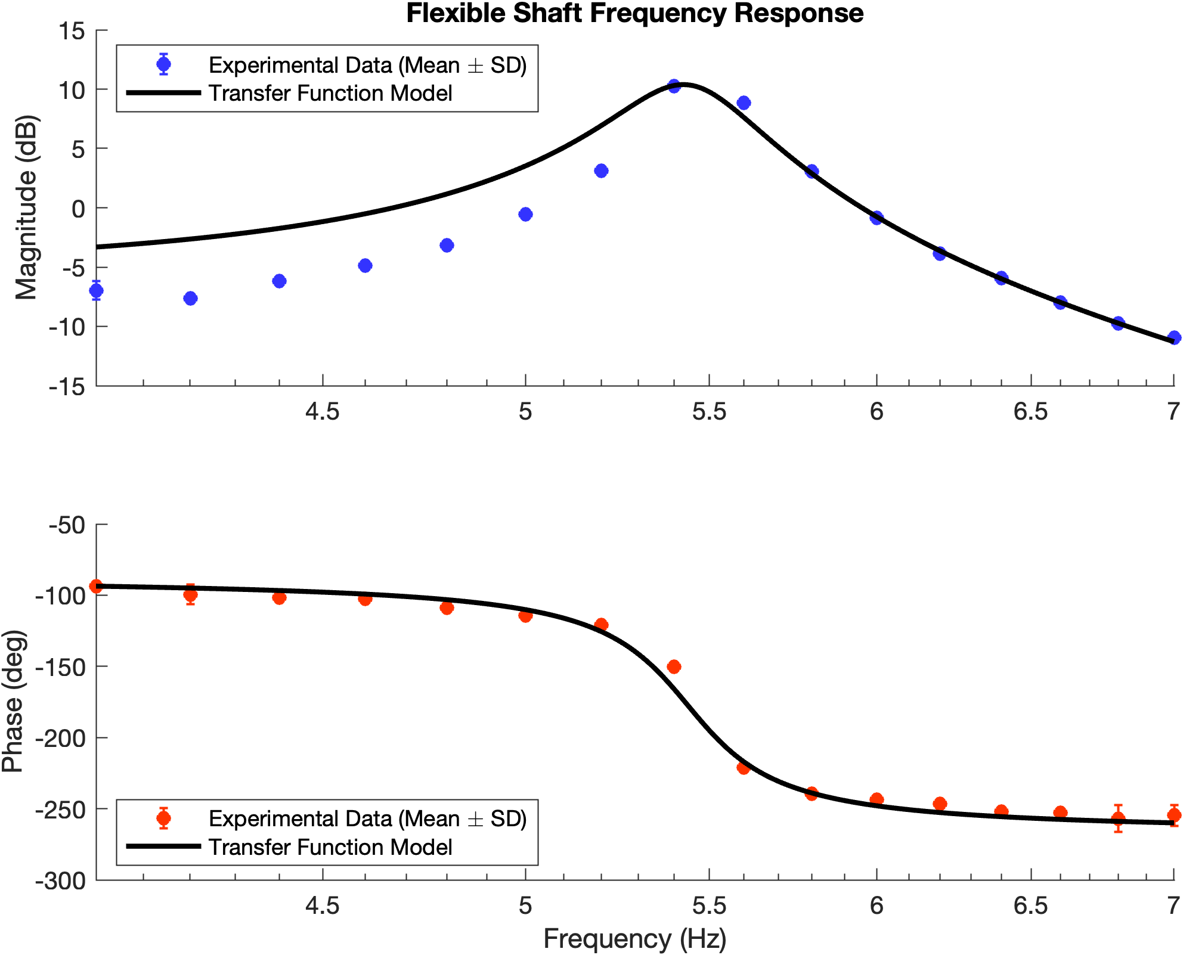
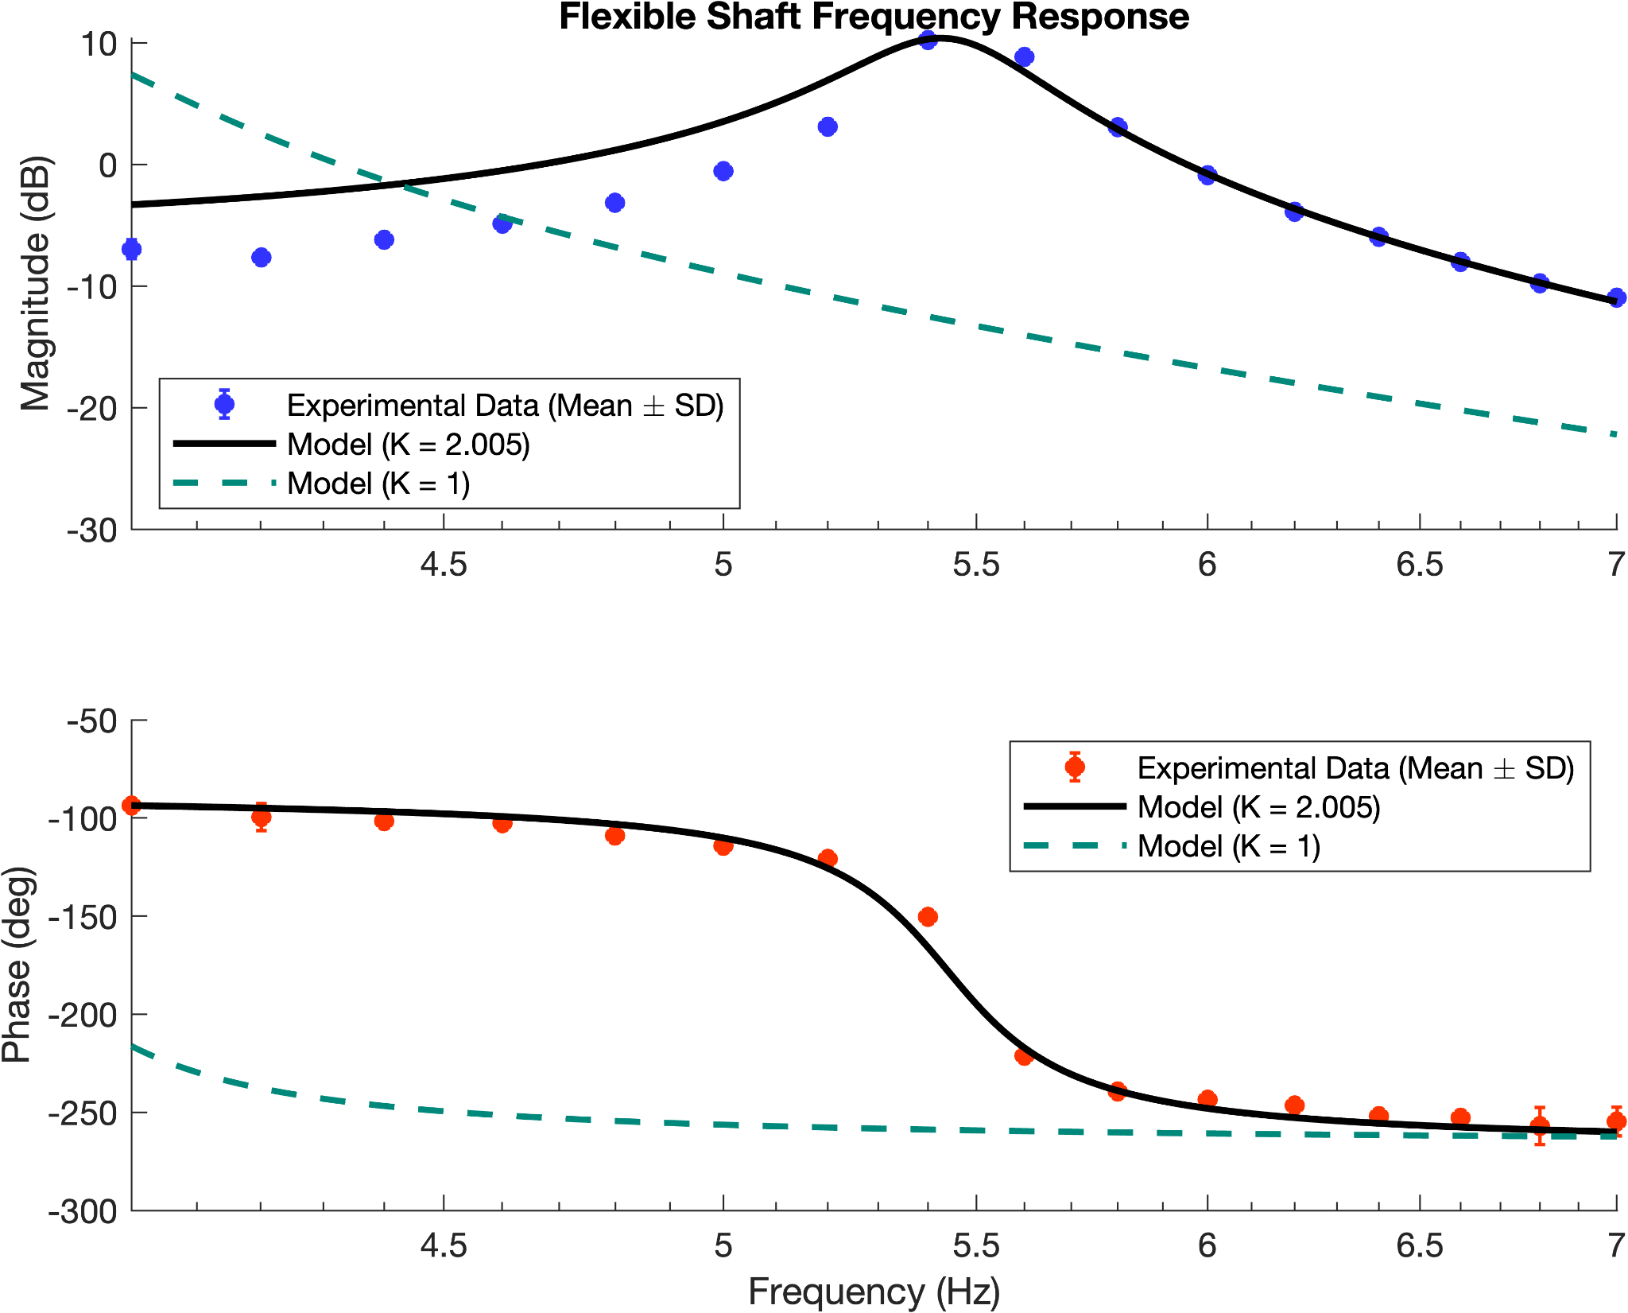
Notes:
11:30-1:30 presentations time
We will have 10min to present, and we will be presenting to experts and non-experts
We will have 4min Q&A
Bring 4 printed copies of the poster and handout

Slide 4
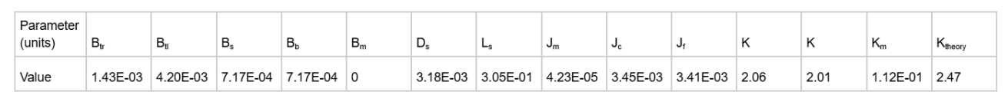
Effective communication:
1. adapt to your audience
2. maximize the signal-to-noise ratio
3. use effective redundancy
Our model matches up nicely with the experimental data on the bode plot. A slight deviation from the experimental data is present before the resonant frequency is reached because our model doesn’t take into account non-viscous damping, which
Derived parameters

Slide 5
Poster Checklist
1. Visual Message
2. Title makes a claim and/or tells us the result
3. Text = 30/40% (text/labels are large enough, use margins & white space)
4. Supporting visuals = 60/70%
5. Limited branding
6. Descriptive headings, logical flow and order (guide the eye)
7. Avoid non-data ink
8. Visuals: resolution & clarity
9. Design so good you don’t know it’s there
Notes:
Information in Poster:
PROBLEM
APPROACHES
KEY FINDINGS
IMPACT OF SOLUTION

Slide 6
Lec 2 notes

Slide 7
